Slide 1

What roles are Challengers playing?
LoL Challenger Data

Slide 2








Want to Learn more?
Learning to use the Riot API is a bit of a struggle. There's very few resources out there and they're not very structured.
“The Riot API Bootcamp Course is designed to take you from no knowledge up to building your own app.”
riot-api-bootcamp.thinkific.com

Slide 3
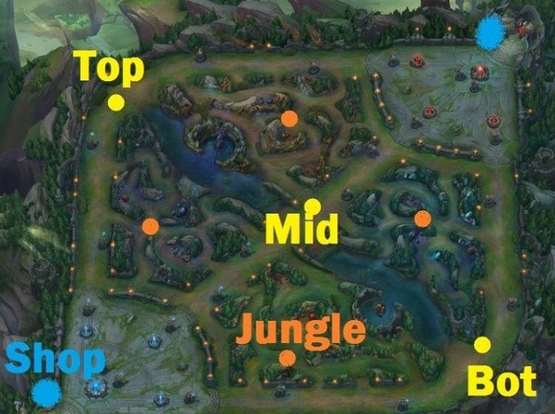
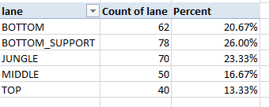
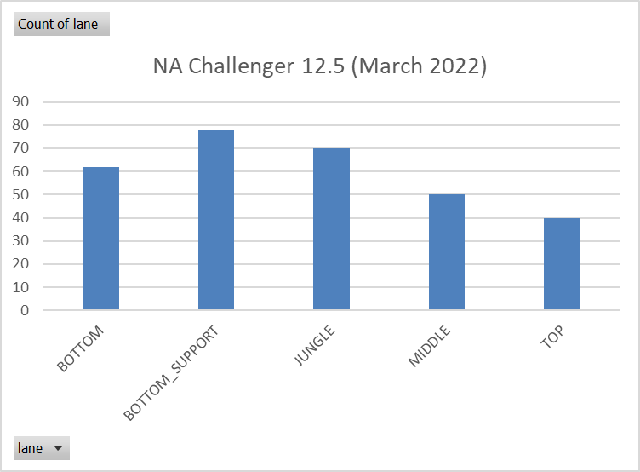
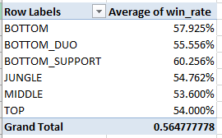
An even distribution?
If all lanes were played equally, they would each be at 20%
A higher representation of a role would also have a higher win-rate since the challenger ladder is a leaderboard
TLDR: For NA Challenger, Support is the most represented and Top is the least

Slide 4

Let’s code this!
What we will need from the Riot API:
Challenger player list [Riot API Bootcamp Project #5]
Most recent match data [Riot API Bootcamp Project #4]
Role/Lane in each match

Slide 5


Questions?
Contact me
It is my hope that this course is easy to understand and follow
Have a question or want additional details? Just reach out!
riot-api-bootcamp.thinkific.com
If you want to know more about my work (LoL Genius) or have questions about something you’re building, LMK!

